Slide 1
CLASSIFICATION OF BRAIN MRI IMAGE USING CNN
CLASSIFICATION OF BRAIN MRI IMAGE USING CNN
Submitted By
Shiva Hemanth D (1NC21CI017)
Harshavardhan J (1NC21CI023)
Under the guidance of
Dr. Rajani K C
DEPARTMENT OF ARTIFICIAL INTELLIGENCE & MACHINE LEARNING
Notes:
We designed this template so that each member of the project team has a set of slides with its own theme where he/she can present their research. Members, here’s how you add a new slide to just your set:
Mark where you want to add the slide: Select an existing one in the Thumbnails pane, click the New Slide button, then choose a layout.
The new slide gets the same theme as the previous one you selected.
Careful! Don’t annoy your fellow presenters by accidentally changing their themes. That can happen if you choose a theme Variant from the Design tab, which changes all of the slides in your presentation to that look.

Slide 2
Context
Abstract
Introduction
Literature Review
Objectives
Methodology
Implementation
Results
Feature Enhancement
Conclusion

Slide 3
Abstract
Brain tumors are a major cause of cancer deaths globally. Accurate diagnosis is essential for proper treatment and patient care. This project uses deep learning with MRI images to classify brain tumors. We propose a convolutional neural network (CNN) to automatically extract features from MRI images and categorize them into different tumor types.​

Slide 4
Introduction
This project is to classify brain MRI images into four categories meningioma, glioma, pituitary tumor, and no tumor.
The classification task involves preprocessing MRI scans, including image normalization, augmentation, and stratified partitioning into training, validation, and test sets.
The aim is to achieve high accuracy in tumor classification using deep learning-trained models on a dataset, to improve clinical decision-making.
The performance of Multilayer Perceptron, InceptionV3, and AlexNet is evaluated using training, validation, and testing phases.

Slide 5
Literature Review​
S.No | Authors | Title | Methodology | Conclusion | Accuracy Rate
1 | Khushi Jaiswal, Meghna Bal, | Brain Tumor Detection and Classification Using a Hyperparameter Tuned Convolutional Neural Network | Convolutional Neural Network (CNN) model | Effect of Convolutional Layers on Performance Impact of Image Augmentation | 93-94.5%

Slide 6
2. | Raghav, Aditya Narayan Das, A. Suresh | Automated Brain Tumor Classification of Different Types of Tumors Using Convolutional Neural Network of Multi Label MRI Scans | Convolutional Neural Network (CNN) model | Improvement in Segmentation Accuracy High Accuracy and Efficiency | 97.14%
3. | R. Meena Prakash, R. Kumari | Classification of MR Brain Images for Detection of Tumor with Transfer Learning from Pre-trained CNN Models | Convolutional Neural Network (CNN) | Utilization of Pre-trained CNN Models Application of Data Augmentation | 98-100%

Slide 7
4. | Muhammad Adeel, Ram Chandra | Brain Tumor Classification Using MRI Images and Convolutional Neural Networks | Convolutional Neural Network (CNN) | Novel CNN-Based Network for Brain Tumor Classification Performance Advantages | 98.6-99%
5. | Surendra Kumar Panda, Ram | MR Brain 2D image Tumor and Cyst Classification Approach: an Empirical Analogy | Support Vector Machine (SVM), K Nearest Neighbors (KNN) | Comparison of Algorithms High Accuracy of Logistic Regression | 99.6%

Slide 8
Objectives
Develop a robust CNN model to accurately classify brain MRI images into categories such as 'Tumor' and 'No Tumor'.
Implement effective data preprocessing and augmentation techniques to enhance model performance and generalization.
Evaluate and fine-tune the model to achieve optimal accuracy and reliability for real-world medical image classification tasks.

Slide 9
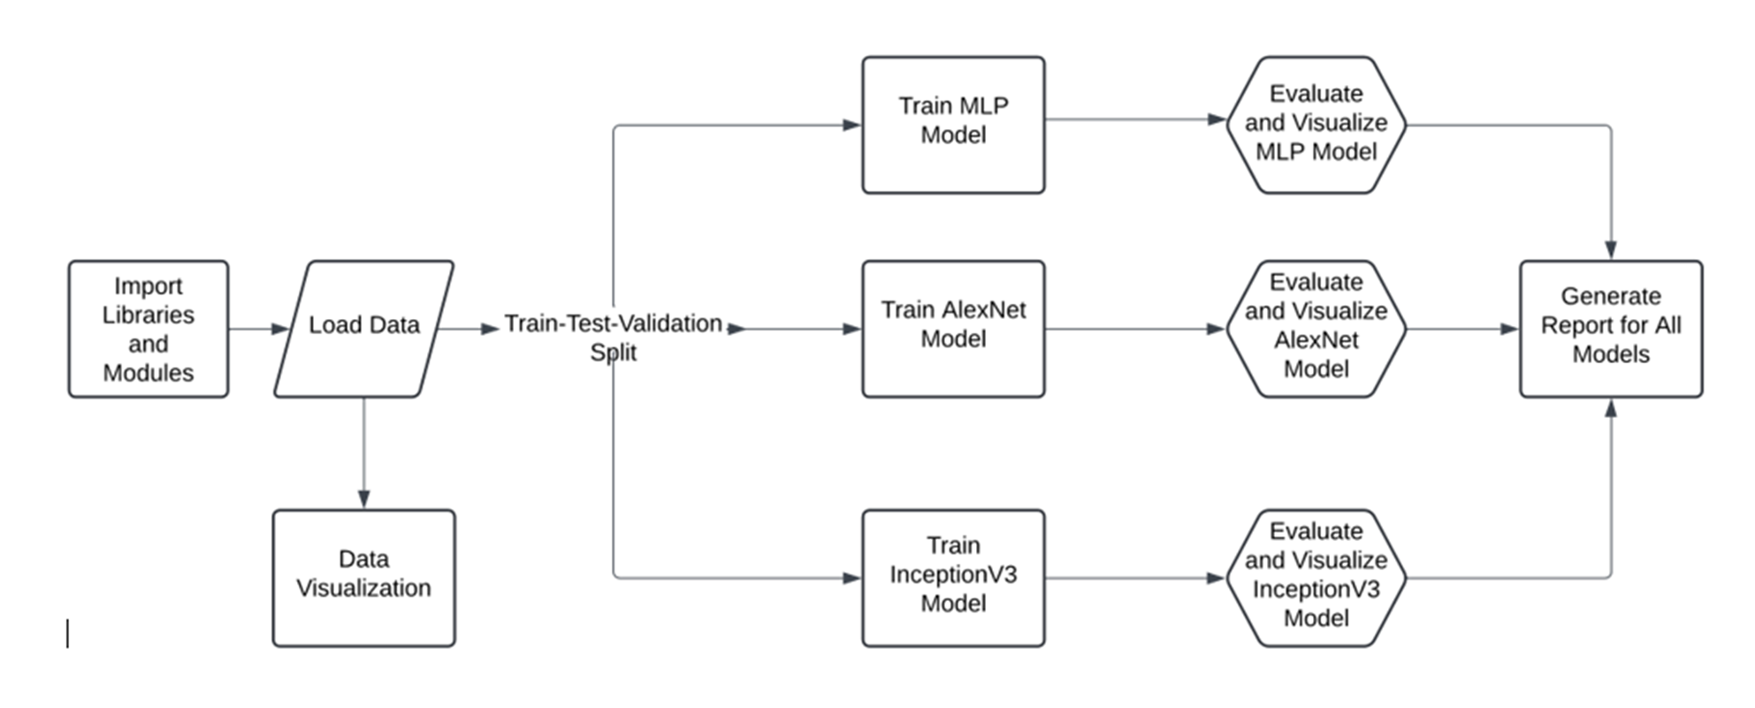
Methodology​

Slide 10
Data Preparation: The first steps involve importing libraries and modules, loading data, and splitting the data into training, testing, and validation sets.
Model Training: The workflow then proceeds to train different models, including a Multilayer Perceptron (MLP) model, an Alex Net model, and an InceptionV3 model, on the prepared data.
Model Evaluation and Visualization: Each model is then evaluated, which involves assessing its performance and potentially visualizing the results to gain insights into its strengths and weaknesses.
Report Generation: Finally, a report is generated that summarizes the performance of all the trained models, allowing for comparisons and informed decision-making.

Slide 11
Implementation

Slide 12
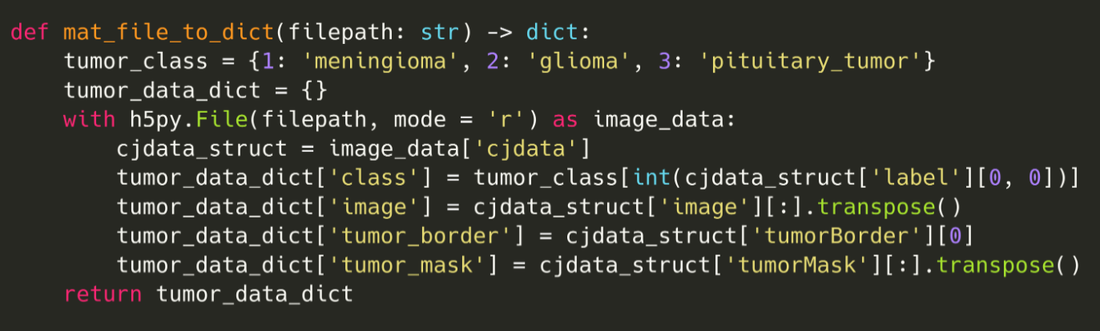
Data Preprossing

Slide 13
Function Definition: Creates a function to convert a MATLAB file to a Python dictionary.
Tumor Class Mapping: Defines a mapping between numerical tumor labels and their corresponding names.
Data Dictionary Initialization: Creates an empty dictionary to store extracted data.
MATLAB File Loading: Opens the specified MATLAB file for reading.
Data Structure Access: Accesses the 'cjdata' structure within the loaded MATLAB file.
Data Extraction: Extracts tumor class, image, tumor border, and tumor mask data and stores them in the dictionary.
Function Return: Returns the filled dictionary containing the extracted data.

Slide 14
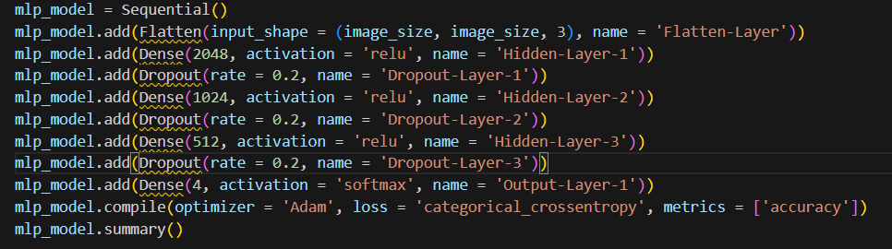
MLP: Multilayer Perceptron
MLP stands for Multilayer Perceptron. It's a type of artificial neural network (ANN) composed of multiple layers of interconnected nodes or neurons.

Slide 15
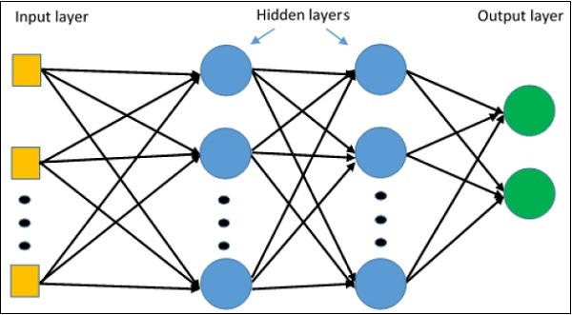
Architecture

Slide 16
The input to the MLP will be a 1-D vector representation of the image of dimension (128, 128, 3) i.e. 49, 152 neurons in the input layer. ​
Total number of hidden layers is 3 with ReLU activation function. ​
Total number of neurons in the output layer is 4 as there are 4 classes with a softmax activation function​

Slide 17
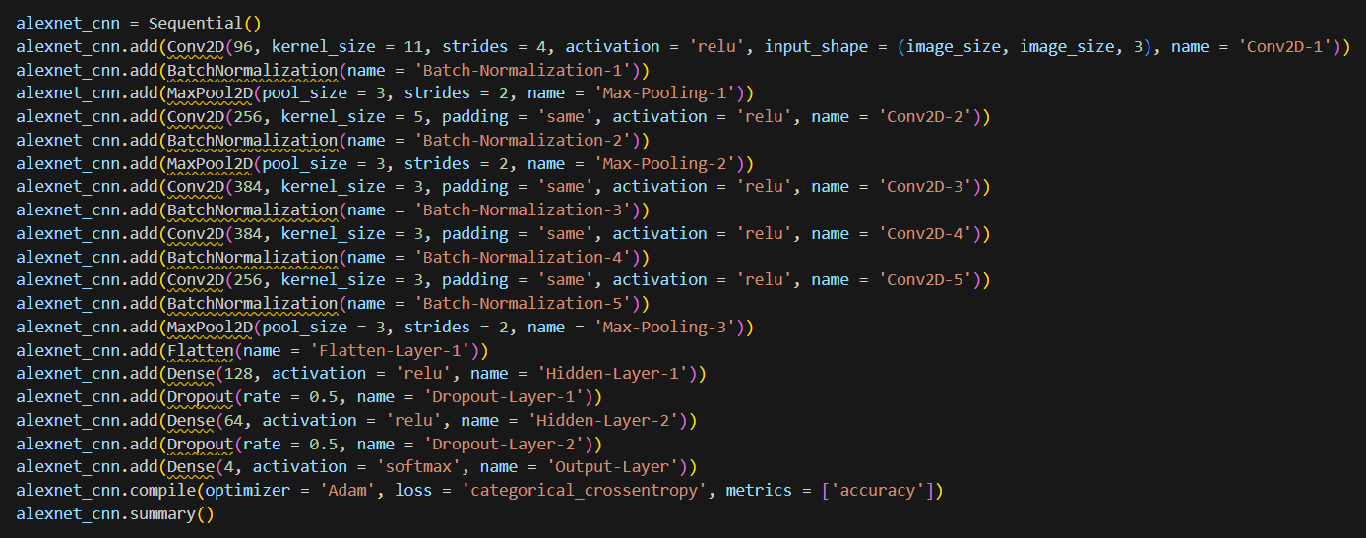
Alex Net
AlexNet is the name of a convolutional neural network (CNN) architecture

Slide 18
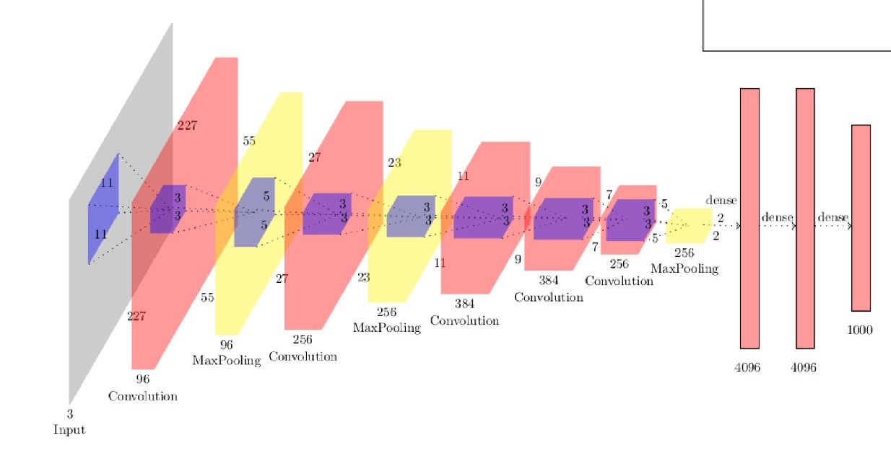
Architecture

Slide 19
The variant of AlexNet which is used consists of 5 Convolutional Layers and 2 Dense Layers (128, 64) and the number of neurons in the output layer is 4 as there are four classes.
Dimension of the input image is (128, 128, 3) and thats the reason why the total number parameters in the model is significantly less than the AlexNet architecture which was trained on ImageNet benchmark dataset.
Total Parameters: 3, 892, 420 ≈ 3.9M.

Slide 20
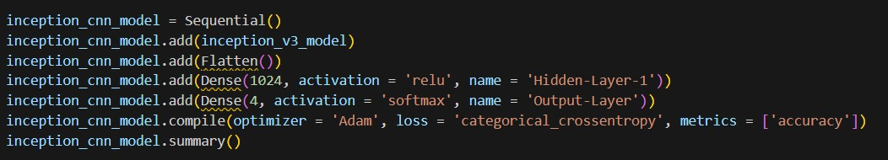
InceptionV3
Inception-v3 is a convolutional neural network that is 48 layers deep. You can load a pretrained version of the network trained on more than a million images from the ImageNet database

Slide 21
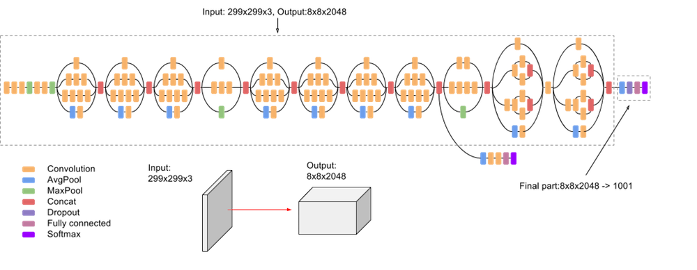
Architecture

Slide 22
Create a Sequential model: A Sequential model is created, which is a linear stack of layers.
Add Inception v3 model: The pre-trained Inception v3 model is added as the first layer. This model is used for feature extraction.
Flatten layer: A Flatten layer is added to convert the 3D output of the Inception v3 model into a 1D vector.
Dense layers: Two Dense layers are added. The first Dense layer has 1024 units and uses the ReLU activation function. The second Dense layer has 4 units and uses the softmax activation function for multi-class classification.
Compile the model: The model is compiled with the Adam optimizer, categorical crossentropy loss function, and accuracy metric. This sets up the model for training.

Slide 23

Results
ThePhoto by PhotoAuthor is licensed under CCYYSA.

Slide 24
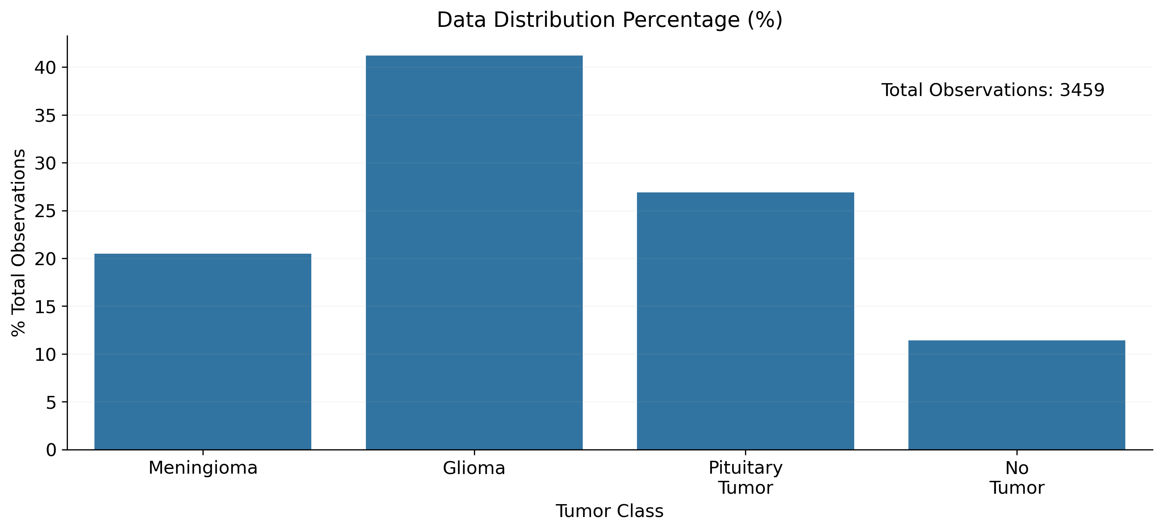

Slide 25
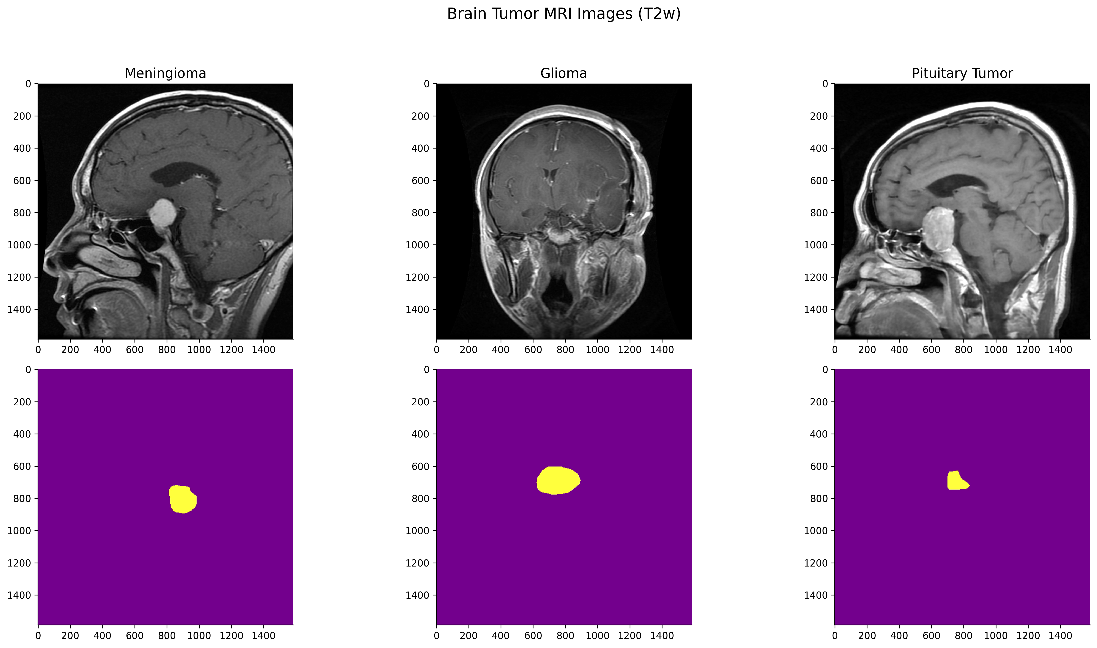

Slide 26
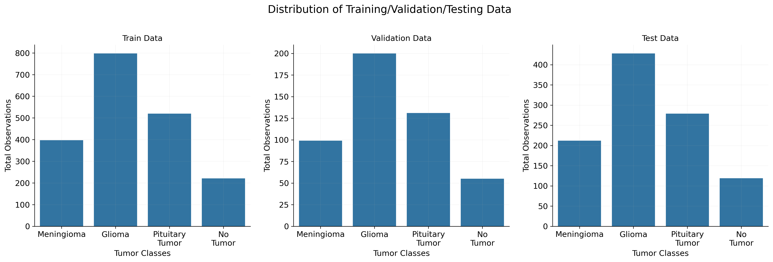

Slide 27
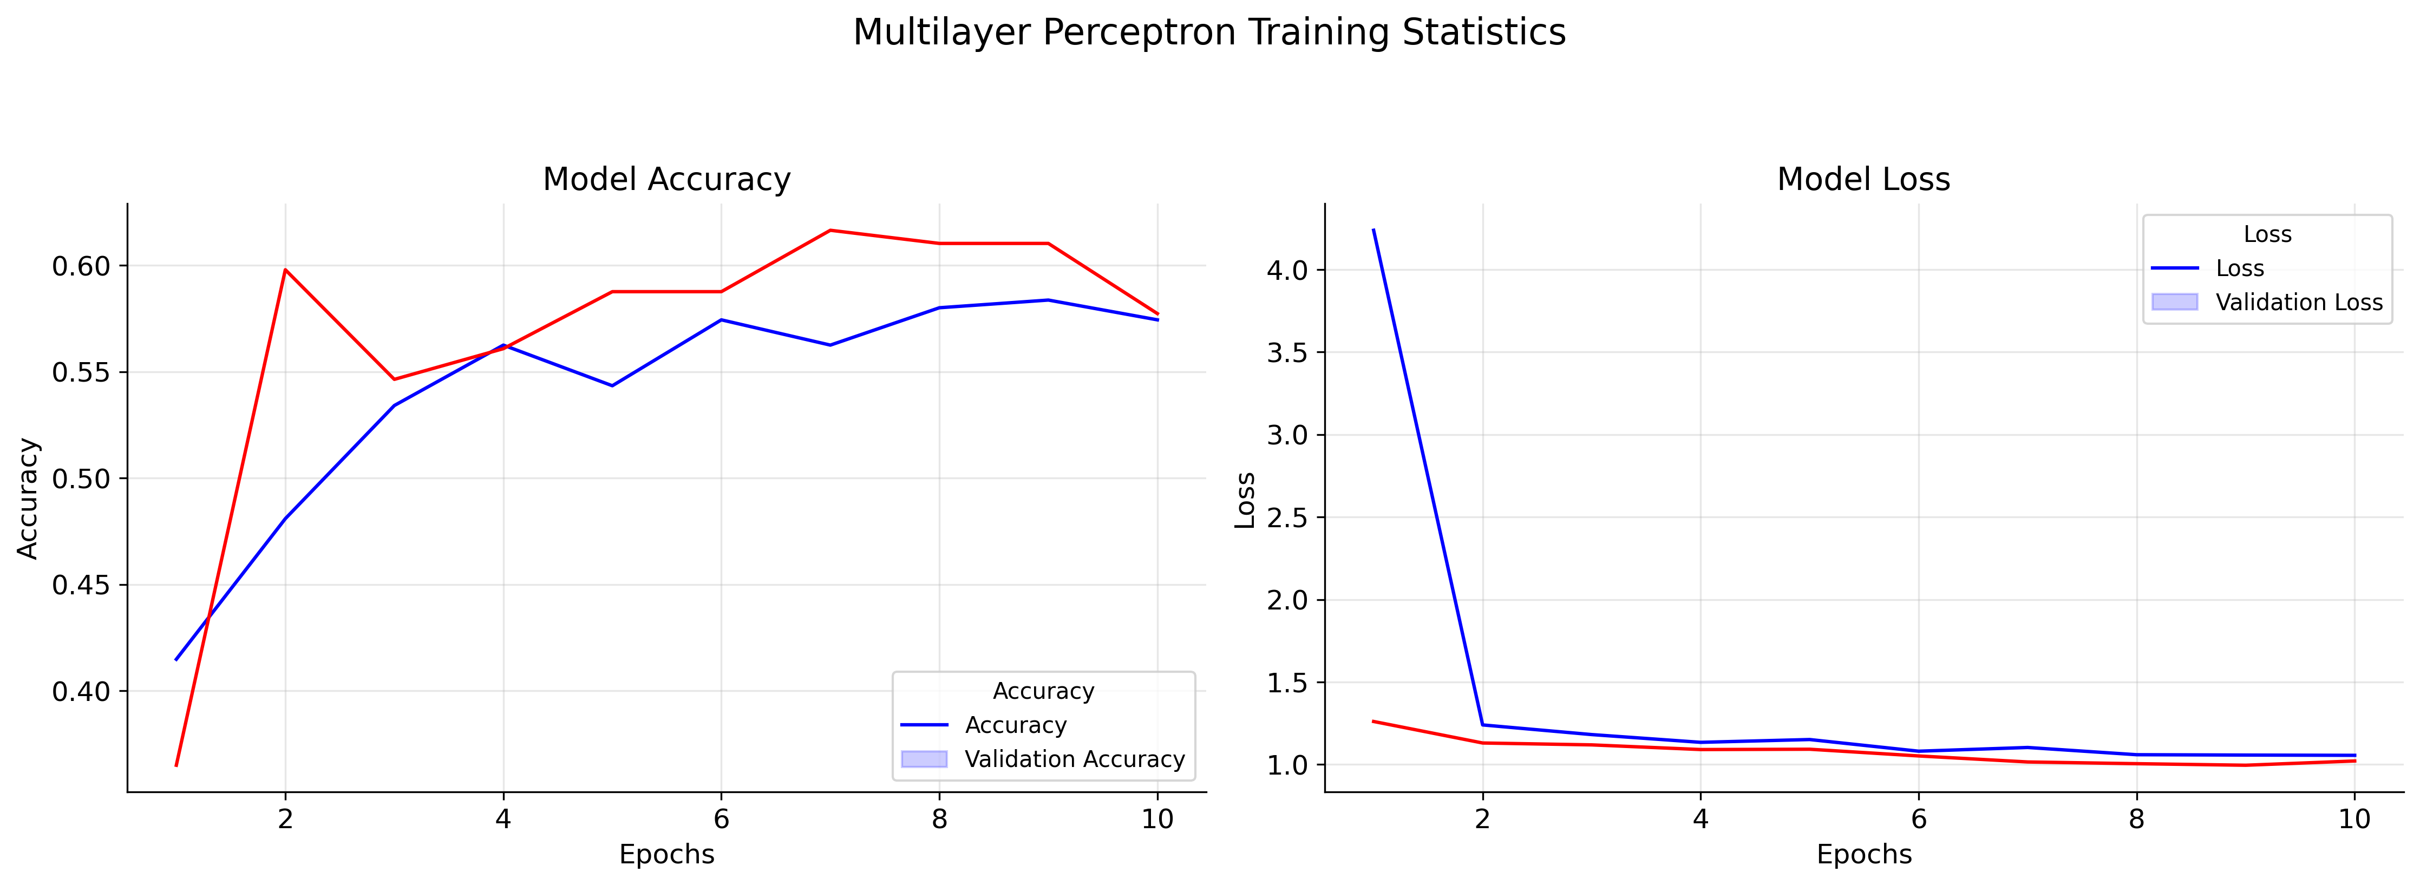
 | MAE | MSE | RMSE | Loss | Accuracy | F1-Score
Multi-Layer-Perceptron Model | 1.516378 | 3.903661 | 1.975768 | 0.99306 | 0.60501 | 0.32948

Slide 28
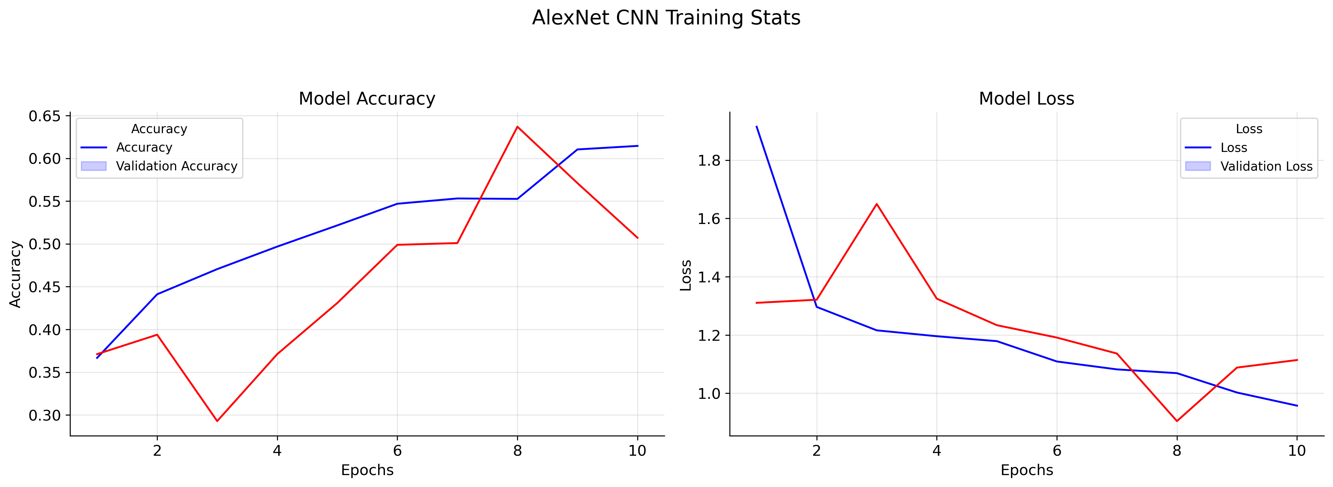
 | MAE | MSE | RMSE | Loss | Accuracy | F1-Score
AlexNet CNN | 1.258189 | 3.028902 | 1.740374 | 1.080837 | 0.528902 | 0.382466

Slide 29
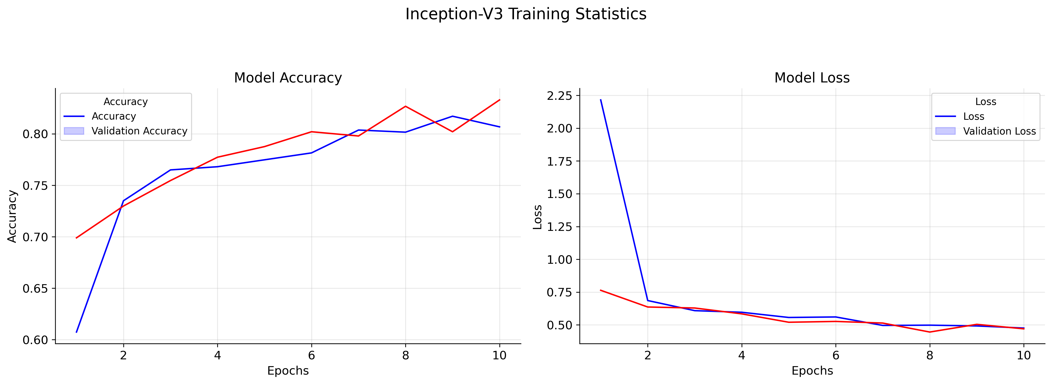
 | MAE | MSE | RMSE | Loss | Accuracy | F1-Score
InceptionV3 | 1.372832 | 3.222543 | 1.795144 | 0.472218 | 0.813102 | 0.310212

Slide 30
 | MAE | MSE | RMSE | LOSS | ACCURACY | F1-SCORE
Multi-Layer-Perceptron Model | 1.394990 | 3.533719 | 1.879819 | 0.926313 | 0.624277 | 0.368979
AlexNet CNN | 1.301541 | 3.205202 | 1.790308 | 1.135692 | 0.607900 | 0.382466
InceptionV3 | 1.365125 | 3.101156 | 1.761010 | 0.452249 | 0.825626 | 0.284200

Slide 31
Feature Work
To incorporate a Data Augmentation pipeline to efficiently generate various different variants of the images to make the model more ruboust.
Training process will be migrated to TPUs (Tensor Processing Units) by representing the data in TFRecord format for significant reduction in training time.
Implementation of R-CNN to not only detect a image which has a tumor in it but to also label the location of the tumor in the image.

Slide 32
Conclusion
CNN models successfully classify the different brain tumors and divided them into four groups
The pre-trained model Inception V3 has performed very well as compared to AlexNet and Multi-Layer Perceptron.
Inception v3 is best model for brain MRI images

